Slide 1
COVID-19 in Canadian Provinces: Rise of COVID-19 cases provincially, for the case increase rates in Canada during 2020-22
TEAM MEMBER AND ROLES:
SAKET MAHAR (Project Manager)
ALIS FINDOLIYA (Data Scientist)
ANKITKUMAR GAMECHI (Data Engineer)
SAI AKHIL GUNJAPADIGE(Visualization Designer)

Slide 2
OBJECTIVE OF THE PROJECT
To analyze COVID-19's impact on Canada, focusing on mortality, recovery, and morbidity rates. Using Statistic Canada's data, this project will create compelling visualizations to aid evidence-based decision-making for policymakers and healthcare professionals on the cases recorded in each province during the period of 2020-2022.
Trends in mortality and recovery rates over time against the daily cases recorded.
Demographic distribution of COVID-19 daily cases in Canada.

Slide 3
PROBLEM STATEMENT
“ Deep data analysis on rise of COVID-19 cases provincially, for the case increase rates of covid in 2020 and 2022 on daily basis “
The overall goal is to empower policymakers and healthcare professionals with actionable insights for effective decision-making regarding the spread of Covid-19 for the peak time of the event which was 2020-2021.

Slide 4

DATA SOURCES
Our analysis draws from a variety of reputable sources to ensure comprehensive coverage and reliability:
Statistic Canada: Provides comprehensive COVID-19 data, including mortality, recovery, and morbidity rates, offering detailed insights into Canada's pandemic situation.
This succinctly introduces the collective data sources and highlights their importance in ensuring the reliability and comprehensiveness of the analysis.
Source: Statistics of Canada-Canadian Economic Dashboard and COVID-19 (statcan.gc.ca)

Slide 5
Library And Tools
NumPy (np):
fundamental for scientific computation and data manipulation.
Pandas (pd):
essential for working with structured data in Python.
Matplotlib (plt):
interactive, and animated visualizations in Python.
Seaborn (SNS):
leveraging Matplotlib's functionality for visualizing relationships in datasets.
Plotly Express (px):
ideal for creating interactive data dashboards and online presentations.
Power BI:
enabling interactive data visualization and insightful reporting for informed decision-making.

Slide 6
DATA PREPARATION
After Collecting the data from valid resources below are the data preparation steps, we considered taking
Data Inspection : Structuring the data
Handling Missing Values : Taking out the inconsistent missing values
Dealing with Duplicates : removing redundant data
Data Transformation : Converting data into suitable format for analysis
Feature Selection : Selecting relevant topics to focus upon to reduce computational complexity

Slide 7
DATA PREPARATION-CONTINUED
We further aim to follow the below steps to refine the data:
6. Data Integration: Integrate data from multiple sources to ensure consistency across datasets.
7. Data Splitting: Splitting the dataset into training, Validation, and testing for model training.
8. Documentation: Document all data preparation and cleaning steps performed on the dataset for transparency and reproducibility.

Slide 8
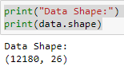
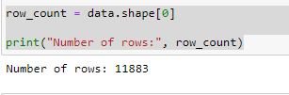
DATA PREPARATION-CONTINUED
Before doing any cleaning of the data
After the data-cleaning process

Slide 9
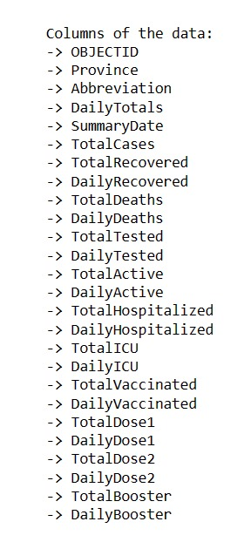
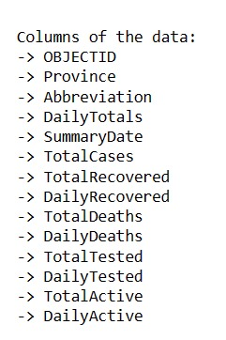
DATA PREPARATION-CONTINUED

Slide 10
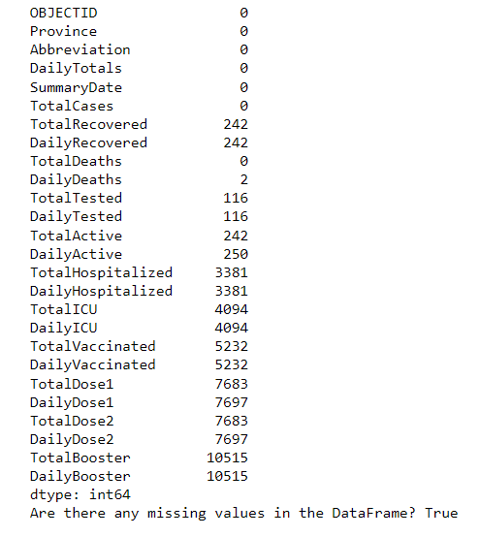
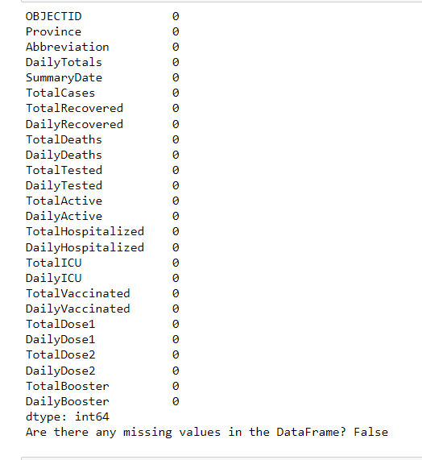
DATA PREPARATION-CONTINUED

Slide 11
DATA MODELLING
Overview:
Transforming raw data into an analyzable format.
Process:
Load data with Pandas.
Select features and target variables.
Split data for training/testing.

Slide 12
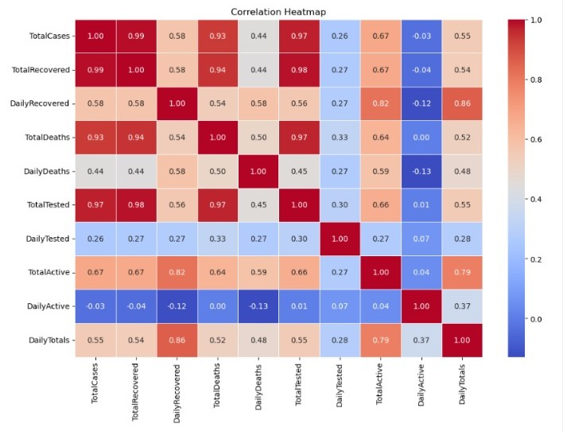
DATA MODELLING-CONTINUED
The heatmap shows the relationship between two continuous variables.
It helps to understand how changing one variable ( independent variable ) would affect changes in another variable ( dependent variable )

Slide 13
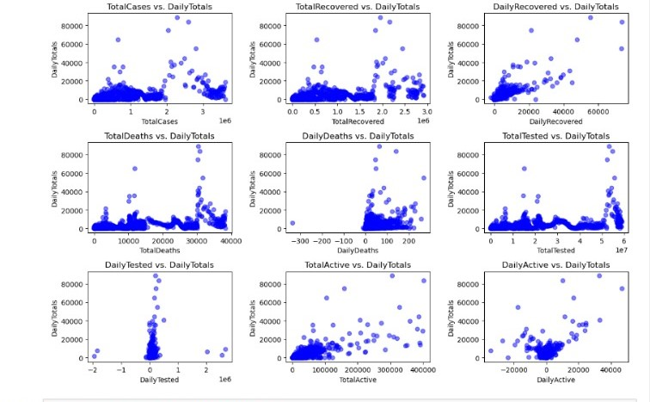
DATA MODELLING-CONTINUED
The scatter chart over here shows the comparison of our target variable i.e the daily total cases with all other variables in the data set for example, TotalCases , TotalRecovered,TotalDeaths..etc

Slide 14
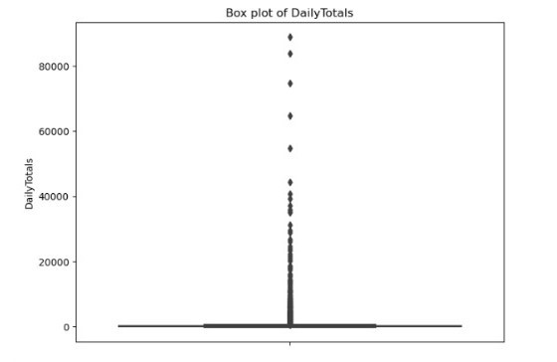
DATA MODELLING-CONTINUED
The box plot chart over here shows the intensity of the daily totals for duration of the 2-year period.
The peak In the middle shows that peak time of when the covid-19 in Canada got the highest number of Daily totals.

Slide 15
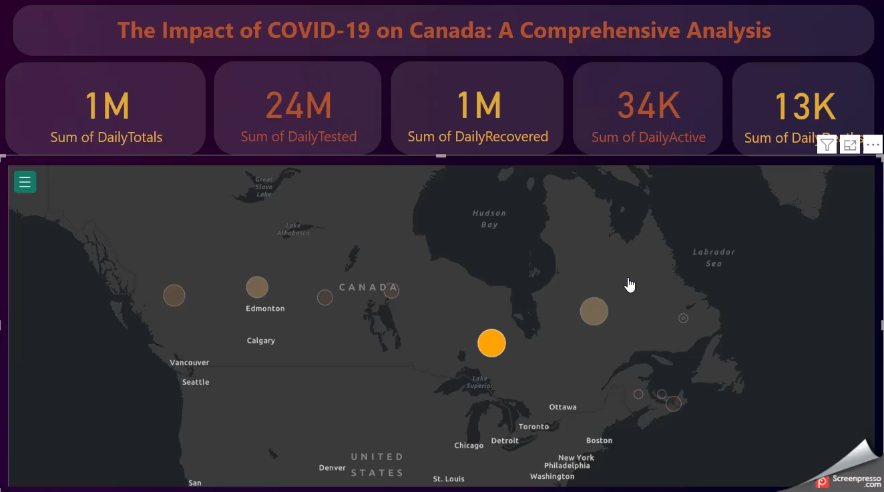
Data Visualization

Slide 16
1. Ontario: As one of the most populous provinces in Canada, Ontario has faced significant challenges in managing the spread of COVID-19, particularly in densely populated urban areas like Toronto. 2. Quebec: Another highly populated province, Quebec, experienced significant outbreaks, particularly in long-term care facilities and urban centers like Montreal. 3. Alberta: Alberta faced challenges with outbreaks in various settings, including workplaces and congregate living facilities. The province also saw a significant impact on its healthcare system during certain periods of the pandemic. 4. British Columbia: While British Columbia managed to control the spread of COVID-19 relatively well in the early stages of the pandemic, it experienced surges in cases at different points, particularly in densely populated areas like Vancouver. 5. Manitoba: Manitoba faced challenges with outbreaks, particularly in certain communities and vulnerable populations. The province implemented various measures to contain the spread of the virus.

Slide 17
Conclusion
Any Questions?

Slide 18
Thank You

